Slide 1
Differentiation-Continuous Functions
by
Dr. Md. Rajibul Islam
CSE, UAP

Slide 2
Differentiation – Continuous Functions

Slide 3
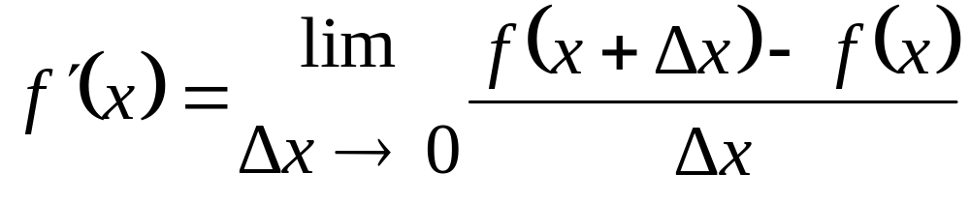

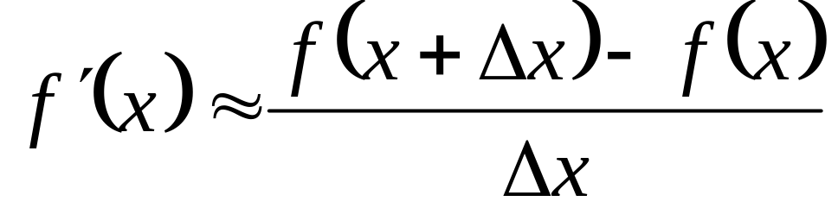
Forward Difference Approximation
For a finite

Slide 4
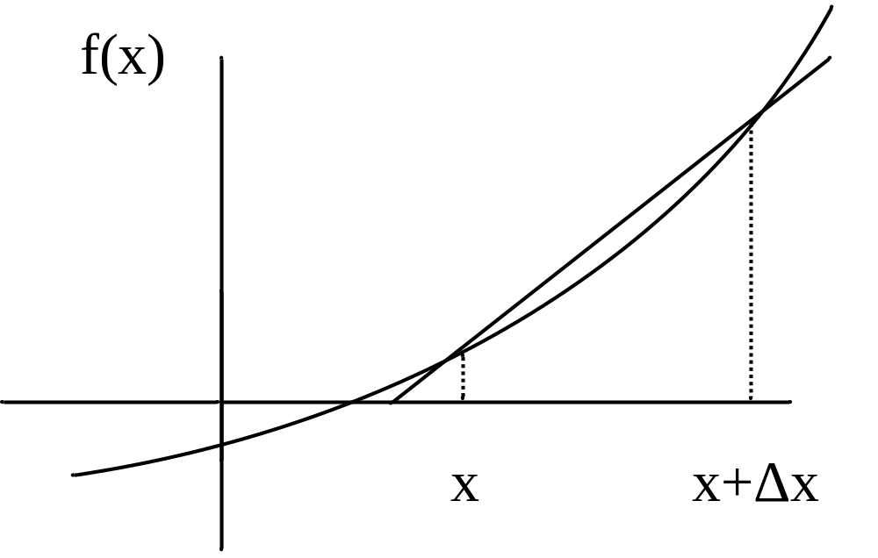
Graphical Representation Of Forward Difference Approximation
Figure 1 Graphical Representation of forward difference approximation of first derivative.

Slide 5
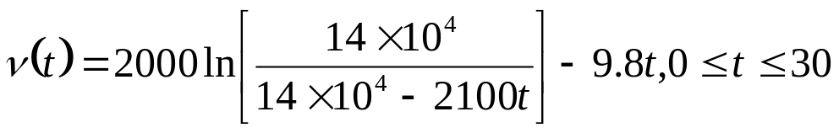





Example 1
The velocity of a rocket is given by
where
is given in m/s and
is given in seconds.
Use forward difference approximation of the first derivative of to calculate the acceleration at . Use a step size of .
Find the exact value of the acceleration of the rocket.
Calculate the absolute relative true error for part (b).

Slide 6
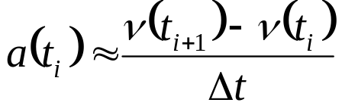


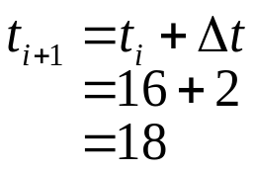
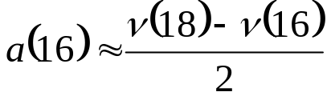
Example 1 Cont.
Solution

Slide 7
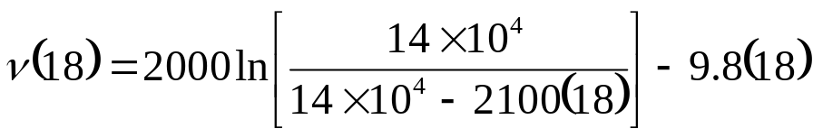

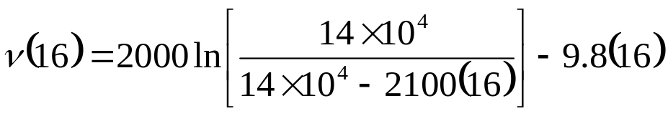

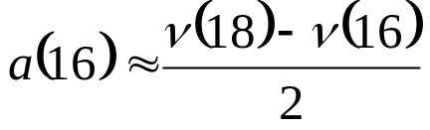
Example 1 Cont.
Hence

Slide 8
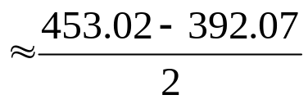


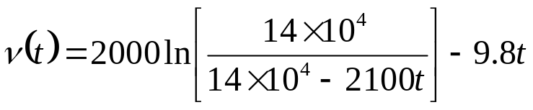
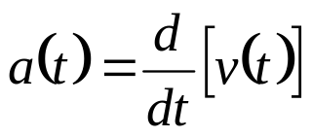
Example 1 Cont.
b)
The exact value of
can be calculated by differentiating
as

Slide 9
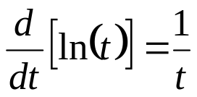
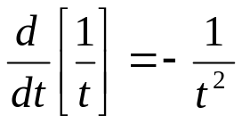
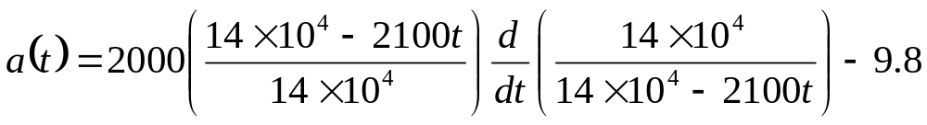
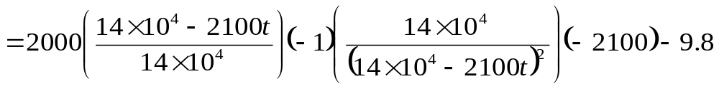
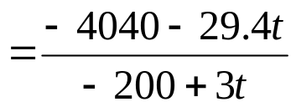
Example 1 Cont.
Knowing that
[Note: You may go to https://www.derivative-calculator.net/
To see the steps]
and

Slide 10
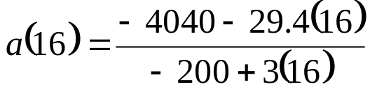

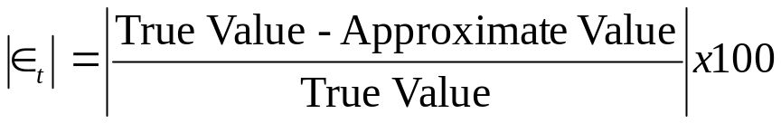
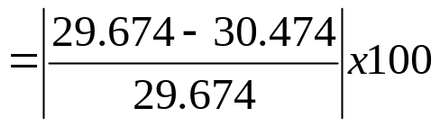

Example 1 Cont.
The absolute relative true error is

Slide 11
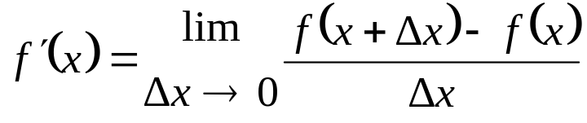

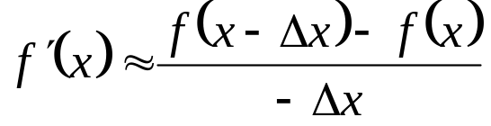
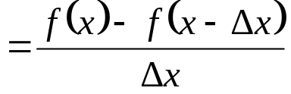
Backward Difference Approximation of the First Derivative
We know
For a finite
,
If
is chosen as a negative number,

Slide 12



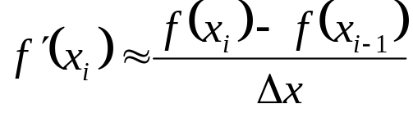
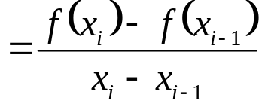

Backward Difference Approximation of the First Derivative Cont.
This is a backward difference approximation as you are taking a point backward from x. To find the value of
at
, we may choose another
point
behind as
. This gives
where

Slide 13
Backward Difference Approximation of the First Derivative Cont.
f(x)
x
x-Δx
x
Figure 2 Graphical Representation of backward difference approximation of first derivative

Slide 14

Example 2
The velocity of a rocket is given by
where
is given in m/s and
is given in seconds.
Use backward difference approximation of the first derivative of to calculate the acceleration at . Use a step size of .
Find the absolute relative true error for part (a).

Slide 15
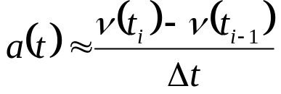
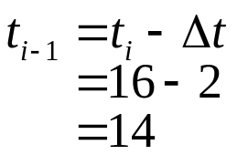
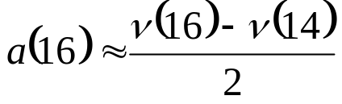
Example 2 Cont.
Solution

Slide 16
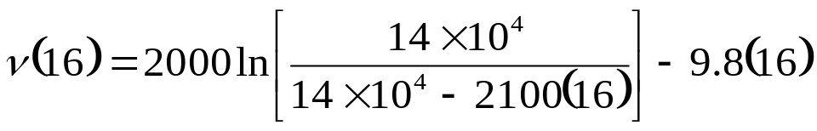
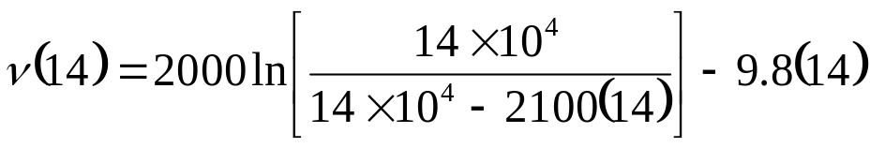


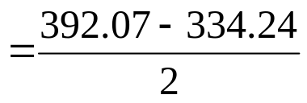

Example 2 Cont.

Slide 17


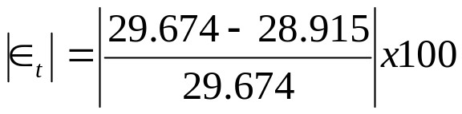

Example 2 Cont.
The exact value of the acceleration at from Example 1 is
The absolute relative true error is

Slide 18


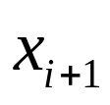
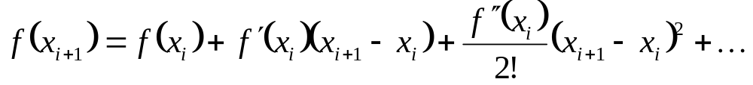

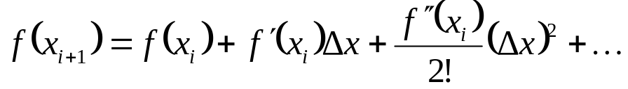
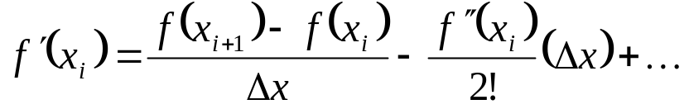
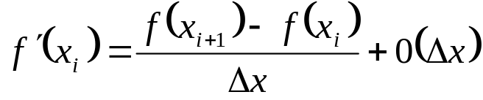
Derive the forward difference approximation from Taylor series
Taylor’s theorem says that if you know the value of a function
at a point
and all its derivatives at that point, provided the derivatives are
continuous between
and
, then
Substituting for convenience

Slide 19



Derive the forward difference approximation from Taylor series Cont.
The
term shows that the error in the approximation is of the order
of
Can you now derive from Taylor series the
formula for
backward
divided difference approximation of the first derivative?
As shown above, both forward and backward divided
difference
approximation of the first
derivative are accurate on the order of
Can we get better approximations? Yes, another method to approximate
the first derivative is called the Central difference approximation of
the first derivative.

Slide 20
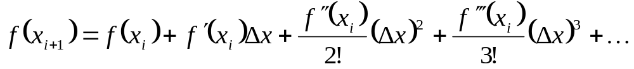
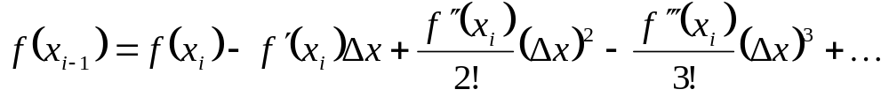
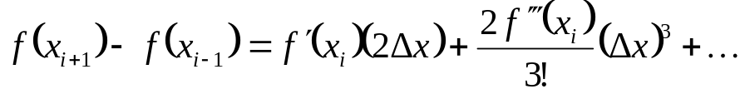
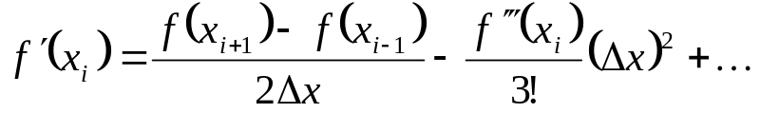
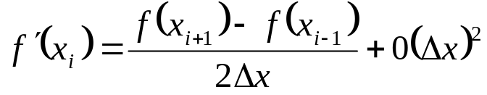
Derive the forward difference approximation from Taylor series Cont.
From Taylor series
Subtracting equation (2) from equation (1)

Slide 21

Central Divided Difference
Hence showing that we have obtained a more accurate formula as the
error is of the order of .
f(x)
x
x-Δx x x+Δx
Figure 3 Graphical Representation of central difference approximation of first derivative

Slide 22
Example 3
The velocity of a rocket is given by
where
is given in m/s and
is given in seconds.
Use central divided difference approximation of the first derivative of to calculate the acceleration at . Use a step size of .
Find the absolute relative true error for part (a).

Slide 23
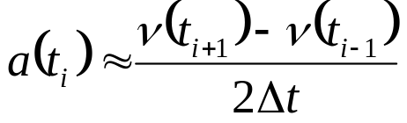


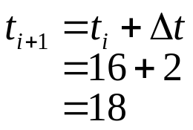
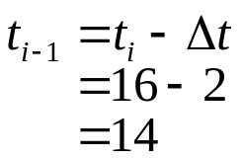
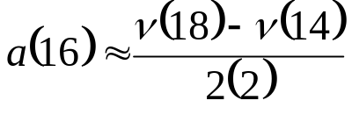
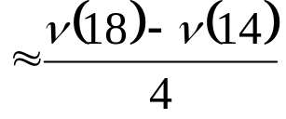
Example 3 cont.
Solution

Slide 24


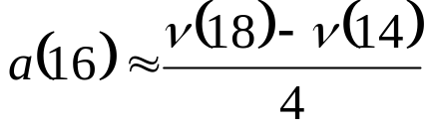
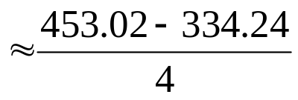

Example 3 cont.

Slide 25




Example 3 cont.
The exact value of the acceleration at from Example 1 is
The absolute relative true error is

Slide 26



Comparision of FDD, BDD, CDD
The results from the three difference approximations are given in Table 1.
Table 1 Summary of a (16) using different divided difference approximations
Type of Difference Approximation
Forward Backward Central | 30.475 28.915 29.695 | 2.6967 2.5584 0.069157

Slide 27



Finding the value of the derivative within a prespecified tolerance
In real life, one would not know the exact value of the derivative – so how
would one know how accurately they have found the value of the derivative.
A simple way would be to start with a step size and keep on halving the step
size and keep on halving the step size until the absolute relative approximate
error is within a pre-specified tolerance.
Take the example of finding
for
at using the backward divided difference scheme.

Slide 28



Finding the value of the derivative within a prespecified tolerance Cont.
Given in Table 2 are the values obtained using the backward difference approximation method and the corresponding absolute relative approximate errors.
Table 2 First derivative approximations and relative errors for
different Δt values of backward difference scheme
2 1 0.5 0.25 0.125 | 28.915 29.289 29.480 29.577 29.625 | 1.2792 0.64787 0.32604 0.16355

Slide 29

Finding the value of the derivative within a prespecified tolerance Cont.
From the above table, one can see that the absolute relative
approximate error decreases as the step size is reduced. At
the absolute relative approximate error is 0.16355%, meaning that
at least 2 significant digits are correct in the answer.

Slide 30





Finite Difference Approximation of Higher Derivatives
One can use Taylor series to approximate a higher order derivative.
For example, to approximate
, the Taylor series for
where
where

Slide 31


Finite Difference Approximation of Higher Derivatives Cont.
Subtracting 2 times equation (4) from equation (3) gives
(5)

Slide 32



Example 4
The velocity of a rocket is given by
Use forward difference approximation of the second derivative of to calculate the jerk at . Use a step size of .

Slide 33





Example 4 Cont.
Solution

Slide 34






Example 4 Cont.

Slide 35





Example 4 Cont.
The exact value of
can be calculated by differentiating
twice as
and

Slide 36

Example 4 Cont.
Knowing that
and

Slide 37




Example 4 Cont.
Similarly it can be shown that
The absolute relative true error is

Slide 38


Higher order accuracy of higher order derivatives
The formula given by equation (5) is a forward difference approximation of
the second derivative and has the error
of the order of
. Can we get
a formula that has a better accuracy? We can get the central difference
approximation of the second derivative.
The Taylor series for
(6)
where

Slide 39




Higher order accuracy of higher order derivatives Cont.
(7)
where
Adding equations (6) and (7), gives

Slide 40


Example 5
The velocity of a rocket is given by
Use central difference approximation of second derivative of to calculate the jerk at . Use a step size of .

Slide 41






Example 5 Cont.
Solution

Slide 42





Example 5 Cont.

Slide 43





Example 5 Cont.
The absolute relative true error is

Slide 44
Additional Resources
Numerical Methods with Applications: Abridged (2nd Edition) – Autar Kaw, Egwu Kalu
  http://mathforcollege.com/nm/topics/textbook_index.html
Introductory Methods of Numerocal Analysis – S. S. Sastry

Slide 45
THE END

